Slide 1
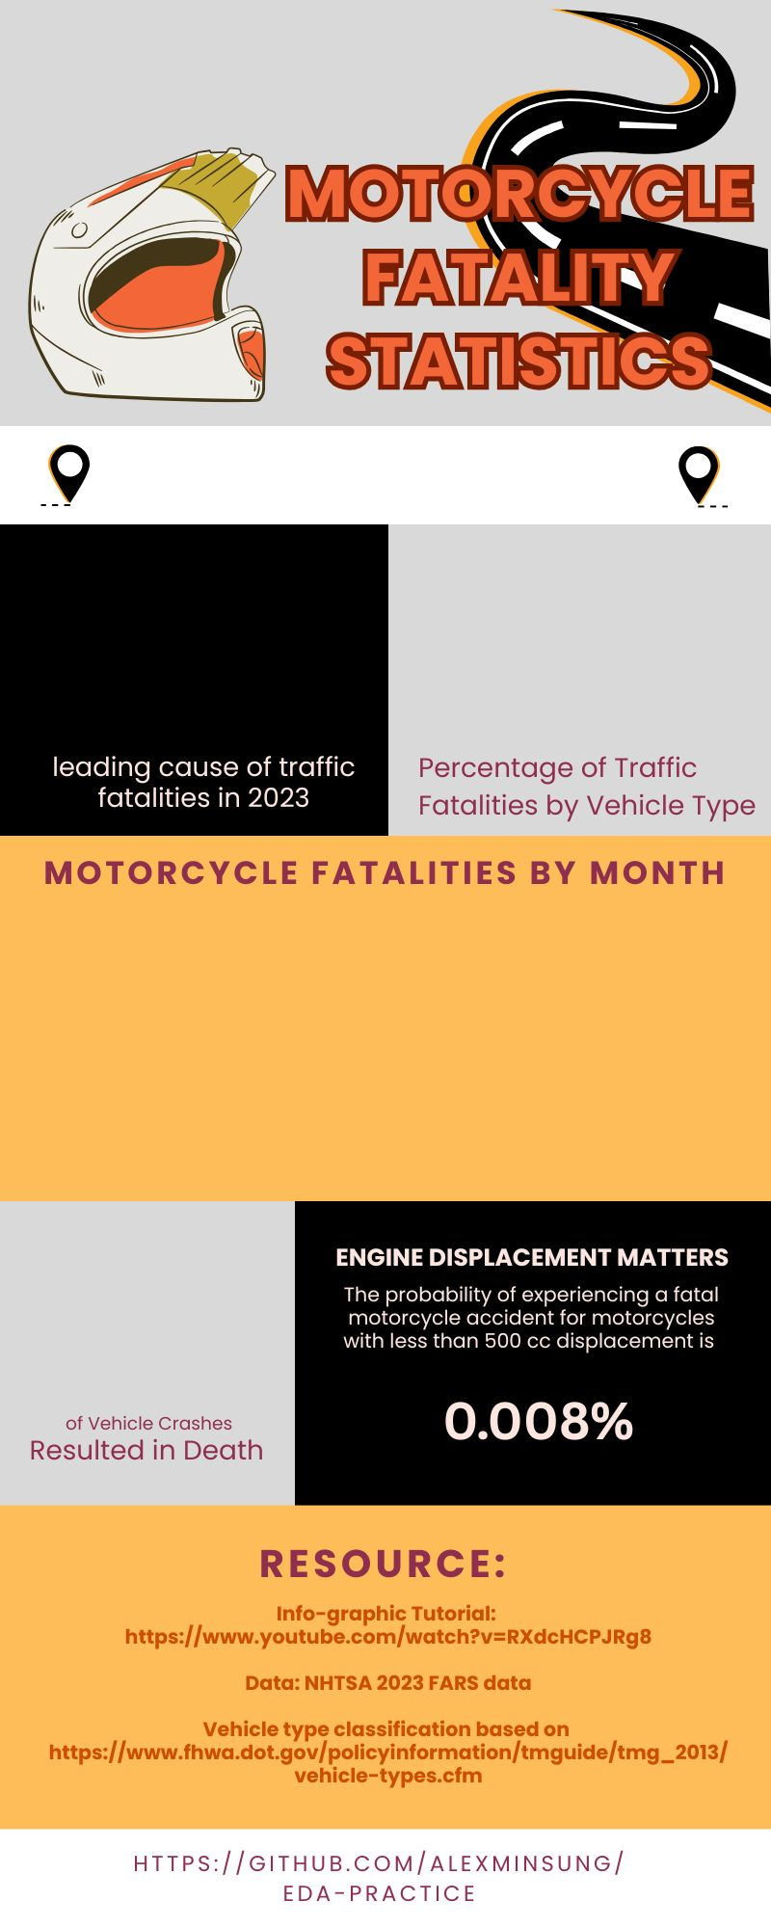
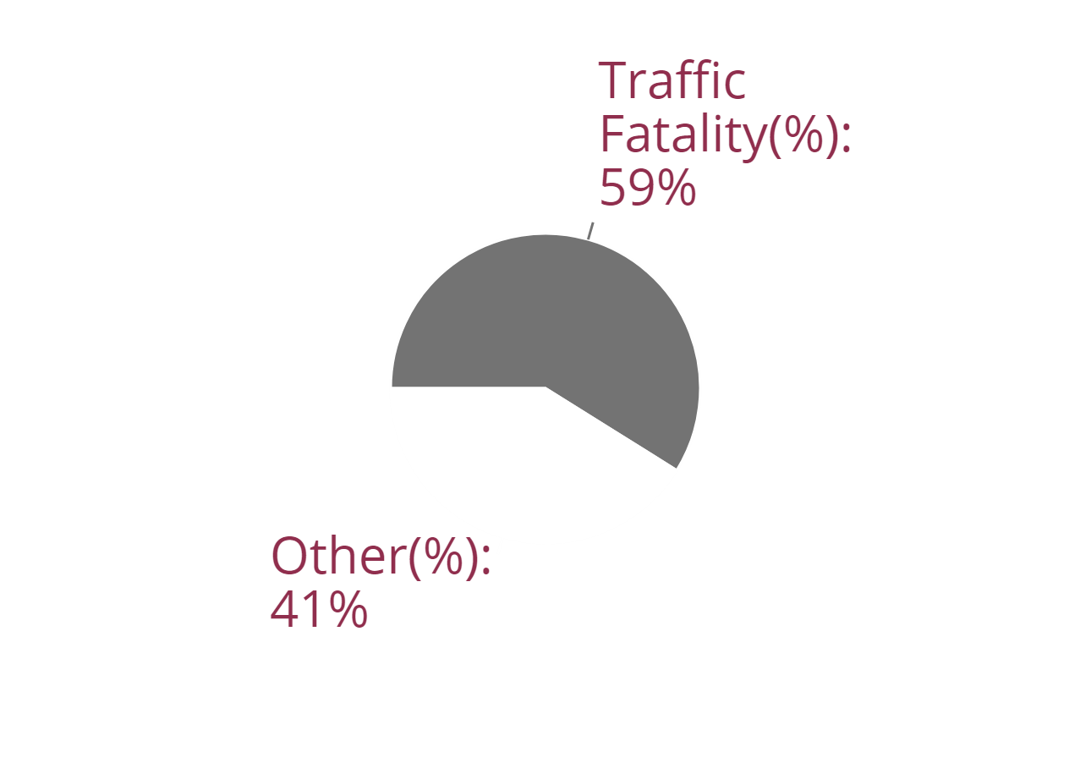
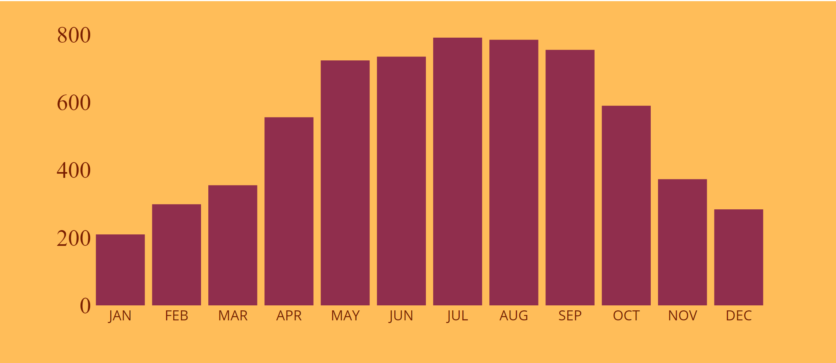
Passenger Cars
#1
37.82%
Notes:
The full infographic can be found at the link: https://app.displayr.com/Dashboard?id=339bcf9d-1200-4b0b-99f5-149bec18c0df#page=4c3e33d5-1715-478b-8b0e-62b8378f39ac
The black bar with the vehicle type functions as a dropdown menu where selecting different vehicle types will produce unique results as seen from following slides.

Slide 2
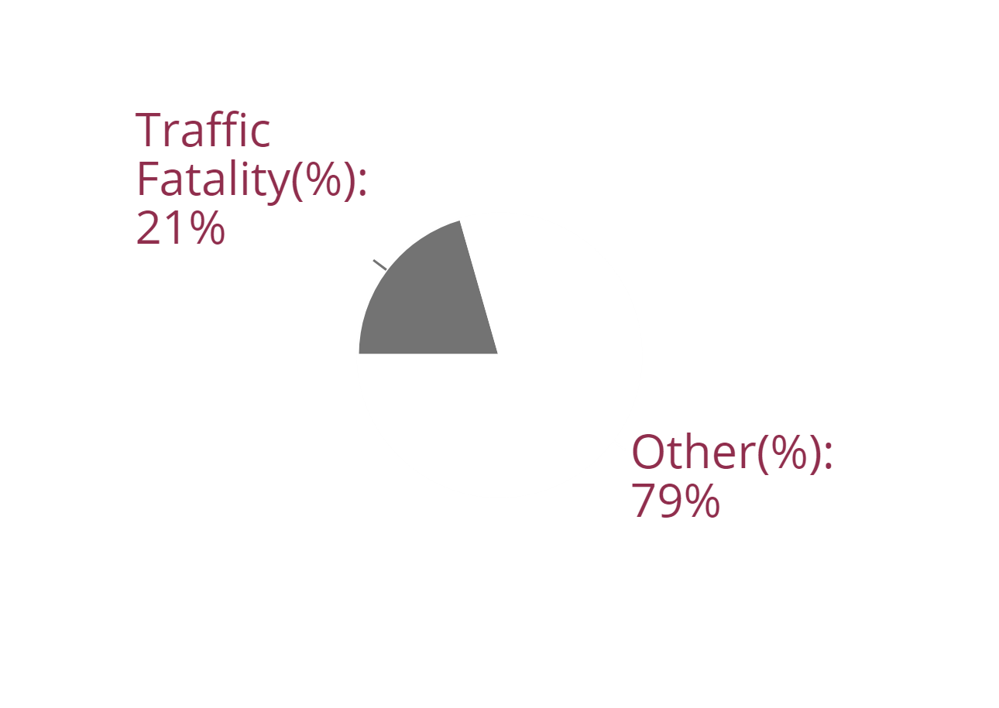
Motorcycle
#2
89.93%

Slide 3
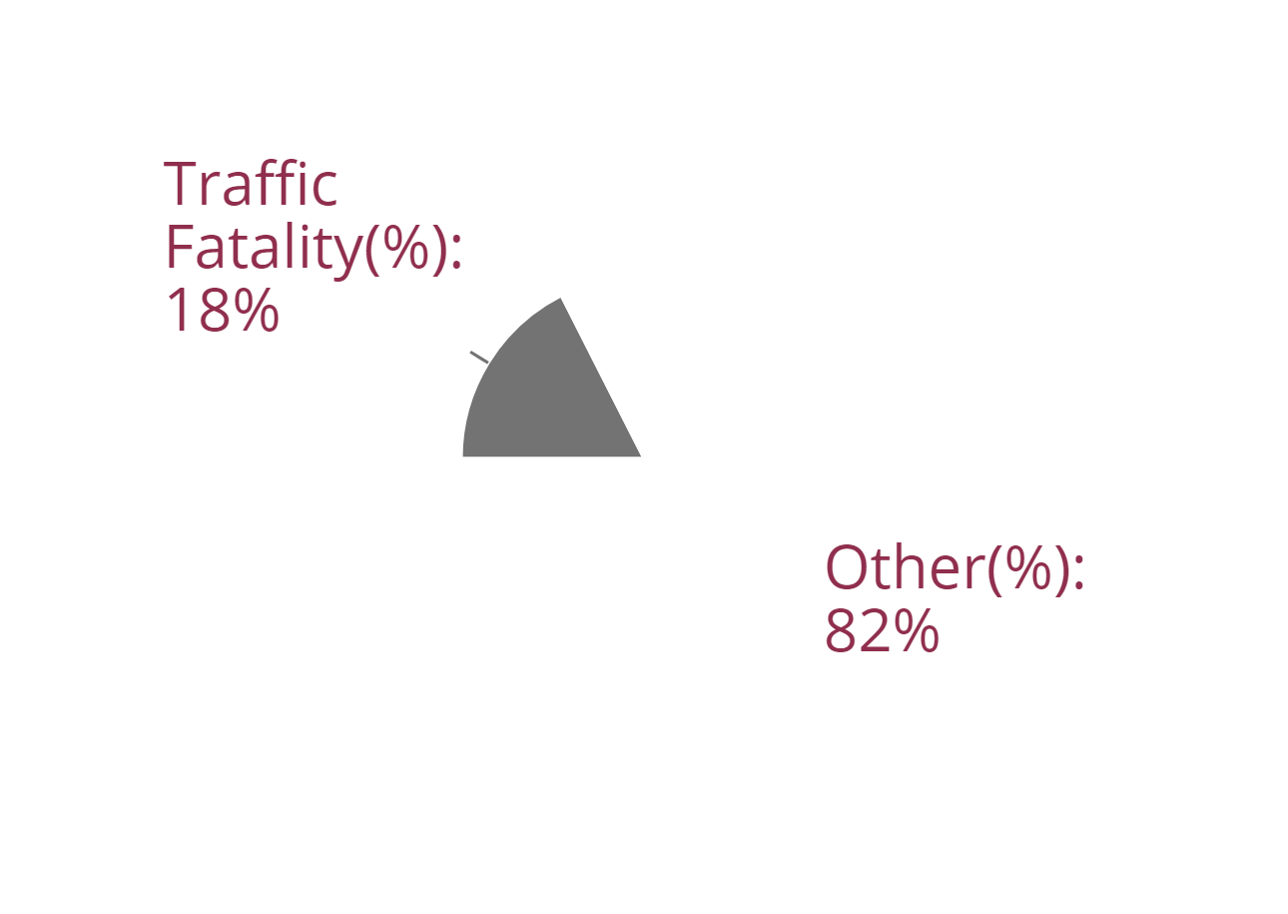
Light Trucks and Vans
#3
30.81%

Slide 4
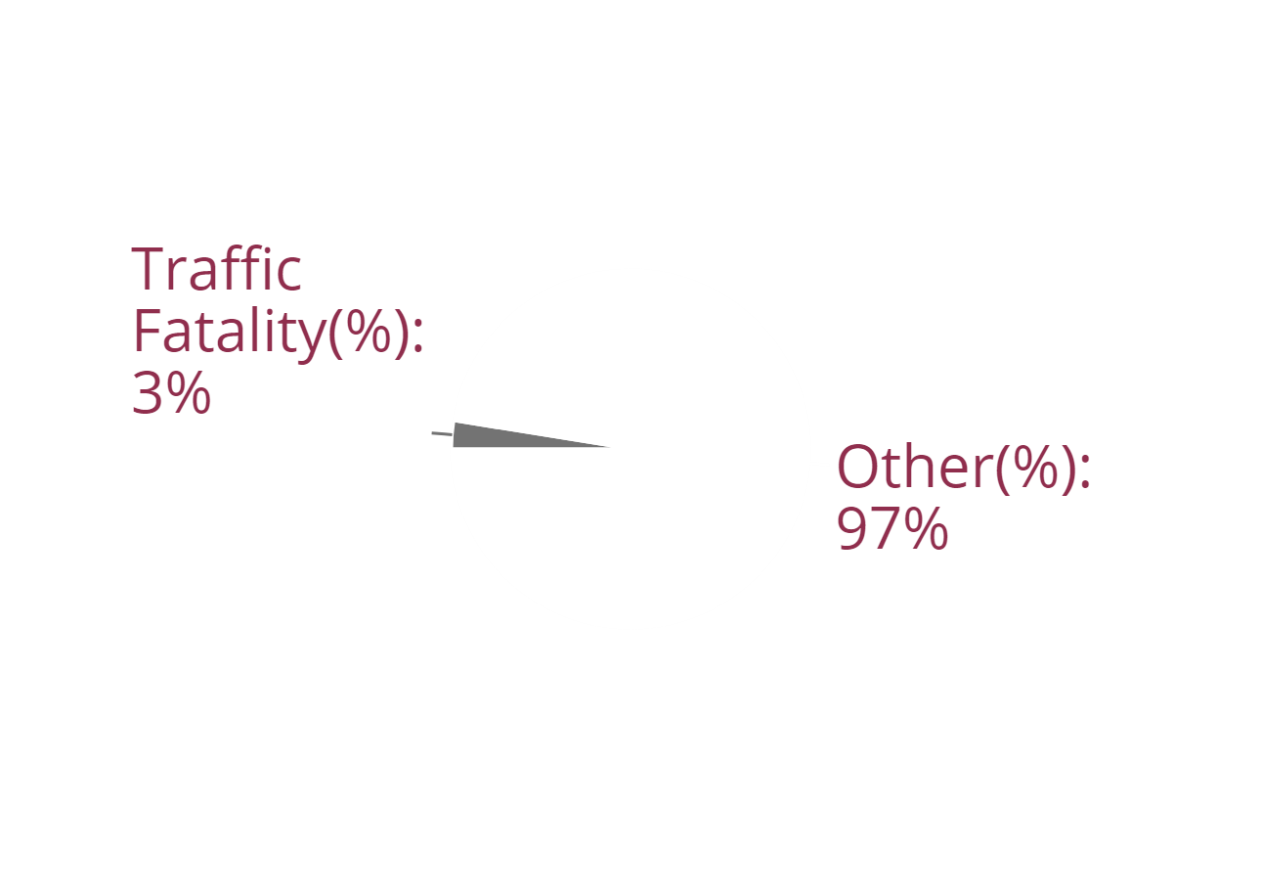
Medium and Heavy Trucks
#4
14.63%

Slide 5
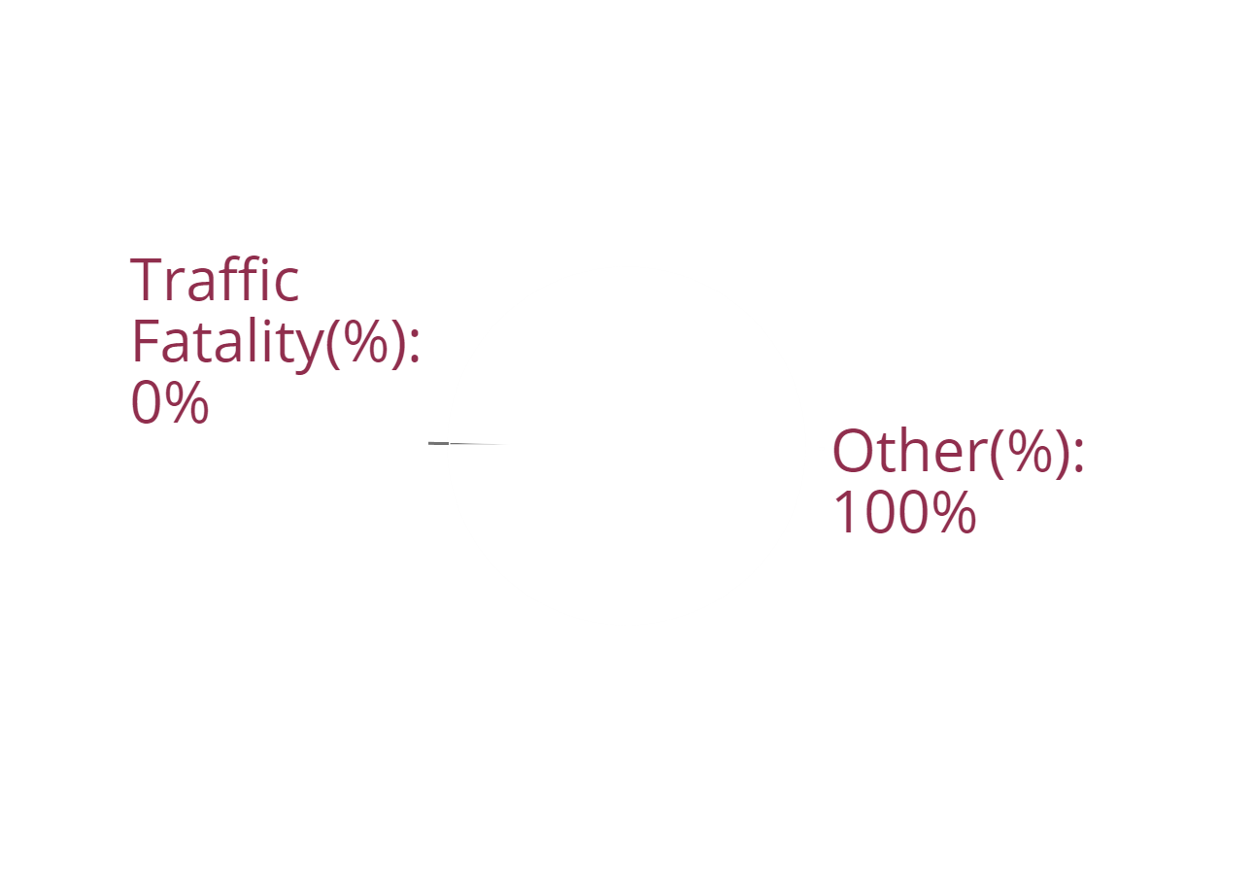
Other
#5
53.47%

Slide 6

Bus
#6
3.32%

